Slide 1
SPRING BOOT WEBCLIENT
#springbootbytes
#codefarm

Slide 2
Reactive HTTP Client
WebClient is a reactive, non-blocking, and asynchronous HTTP client introduced in the Spring WebFlux module.
It is designed to handle reactive programming principles and is suitable for building reactive applications.

Slide 3
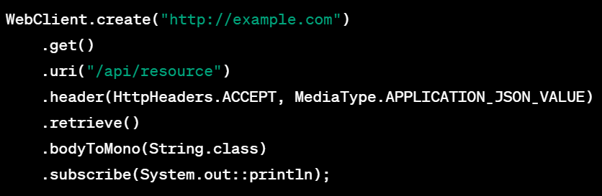
Fluent API for Building Requests
It provides a fluent and expressive API for building HTTP requests.
Developers can chain methods to define various aspects of the request, such as the HTTP method, URI, headers, and request body.

Slide 4
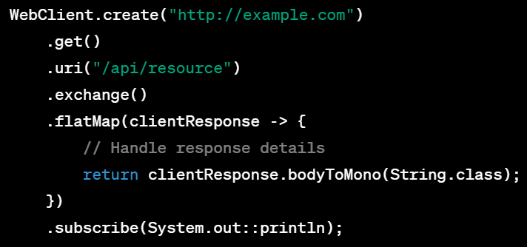
Exchange Function for Full Control
For more advanced use cases, WebClient provides an exchange() method that returns a ClientResponse.
This gives you full control over the request and response, allowing you to inspect headers, status codes, and more.

Slide 5
Reactive Response Handling
WebClient supports reactive streams, allowing you to handle the response asynchronously.
The retrieve() method returns a BodySpec that can be used to extract and process the response body in a reactive manner.

Slide 6
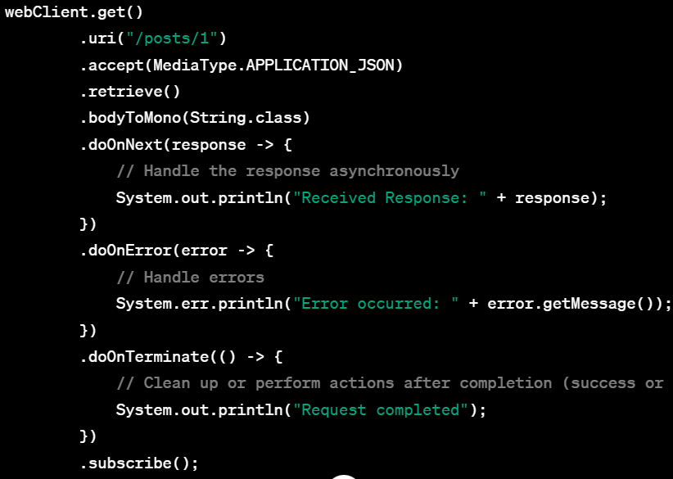
Reactive Response Handling example

Slide 7
Integration with Spring Ecosystem
WebClient integrates seamlessly with other components in the Spring ecosystem, making it a natural choice for Spring Boot applications.
It can be used in conjunction with Spring WebFlux controllers and services, providing a consistent reactive programming model.

Slide 9
WHY CHOOSE SPRING BOOT?
#springbootbytes
#codefarm

Slide 10
Rapid Development
Spring Boot is designed to accelerate the development of Spring applications by providing defaults for code and configuration.
It aims to get you up and running with minimal effort, allowing developers to focus more on business logic rather than boilerplate code.

Slide 11
Microservices Architecture
Spring Boot is well-suited for building microservices-based applications.
It simplifies the development of small, independent services by providing features like embedded servers, production-ready defaults, and a variety of libraries for building different components of a microservices architecture.

Slide 12
Embedded Servers
Spring Boot comes with embedded servers like Tomcat, Jetty, and Undertow, which eliminates the need for deploying applications on external servers.
This makes it easier to package your application as a standalone JAR or WAR file, simplifying deployment and reducing the need for external dependencies.

Slide 13
Opinionated Defaults
Spring Boot adopts an opinionated approach by providing sensible defaults for various configuration options.
This allows developers to get started quickly without having to make a myriad of decisions about configuration. However, it also allows for customization when needed.

Slide 14
Spring Ecosystem Integration
Spring Boot seamlessly integrates with the broader Spring ecosystem, including the Spring Framework, Spring Data, Spring Security, and other projects.
This integration simplifies the development of enterprise-grade applications, offering a comprehensive set of tools and libraries for various aspects of application development.

